Slide 1
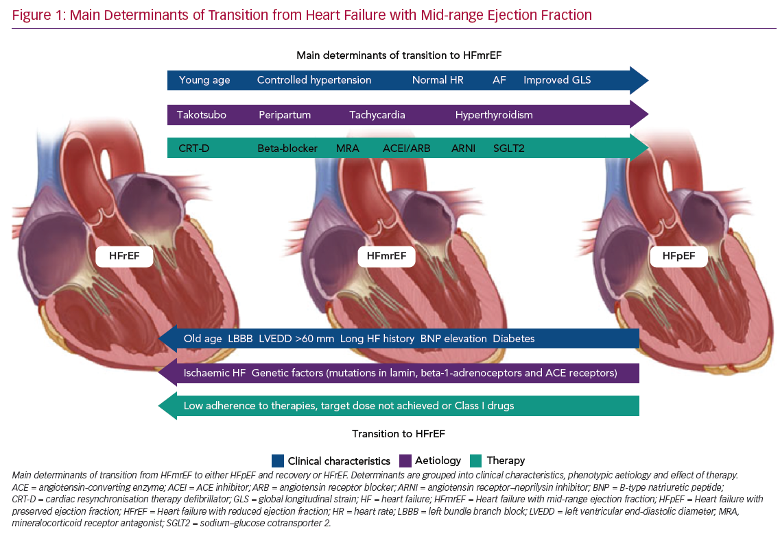
Margonato D, Mazzetti S, De Maria R, Gorini M, Iacoviello M, Maggioni AP, Mortara A
Main Determinants of Transition from Heart Failure
Citation: Cardiac Failure Review 2020;6:e28.
https://doi.org/10.15420/cfr.2020.13

