Slide 1

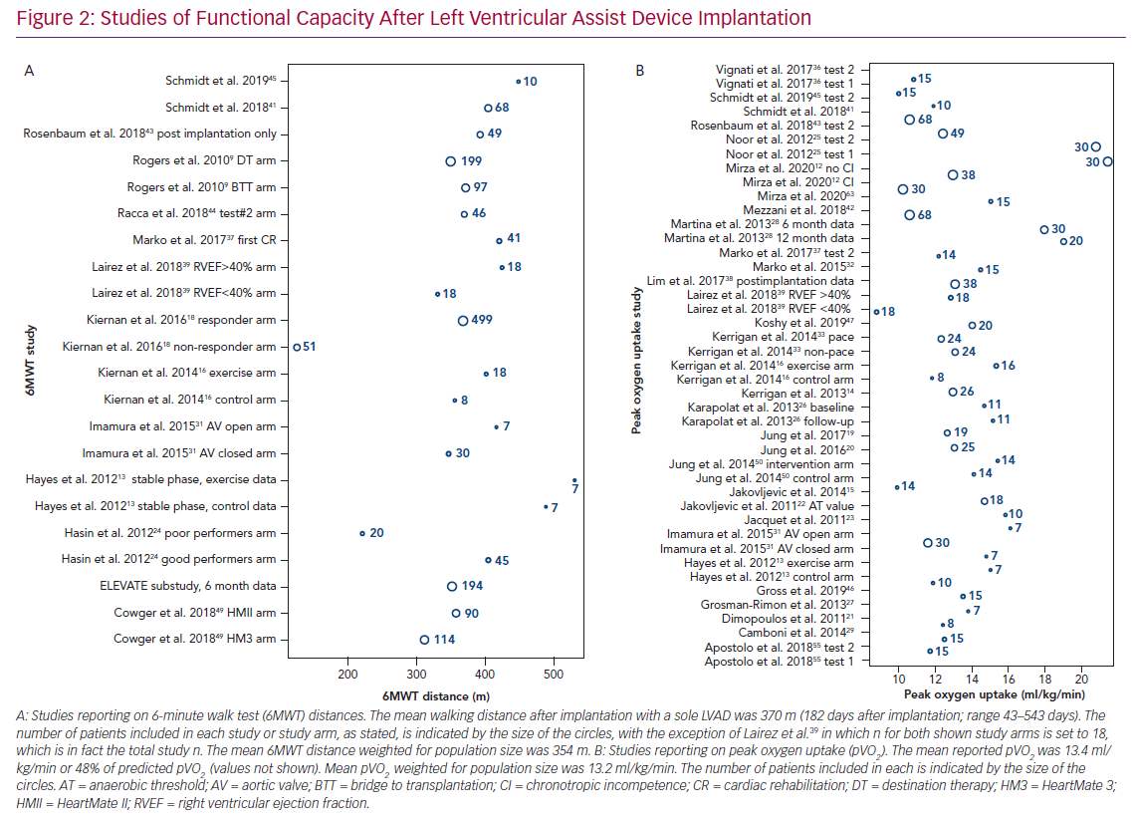
Mirza KK, Gustafsson F
Studies of Functional Capacity After Left Ventricular
Citation: Cardiac Failure Review 2020;6:e29.
https://doi.org/10.15420/cfr.2020.15

