Slide 1
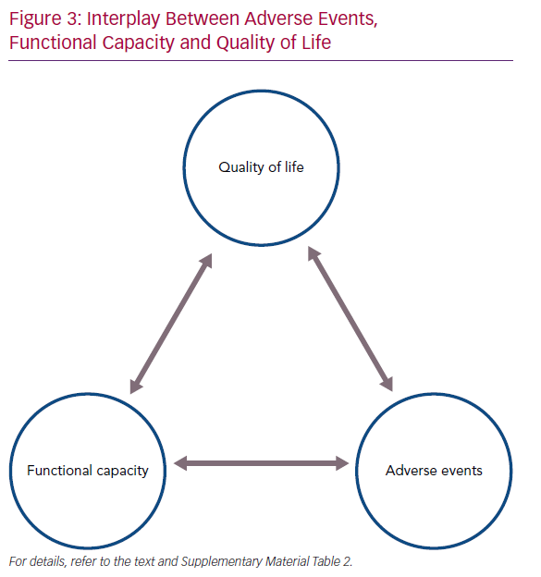
Mirza KK, Gustafsson F
Interplay Between Adverse Events
Citation: Cardiac Failure Review 2020;6:e29.
https://doi.org/10.15420/cfr.2020.15

