Slide 1
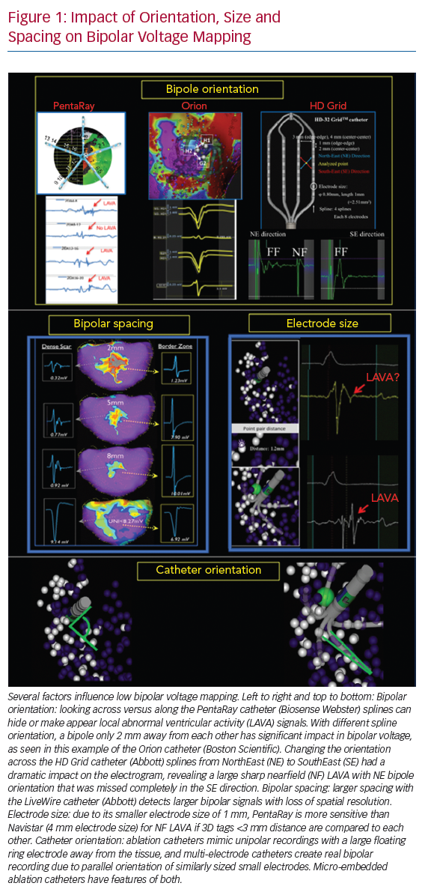
Berte B, Zeppenfeld K, Tung R
Impact of Orientation, Size and Spacing on Bipolar Voltage Mapping
Citation: Arrhythmia & Electrophysiology Review 2020;9(3):128–35.
https://doi.org/10.15420/aer.2020.24

