Slide 1
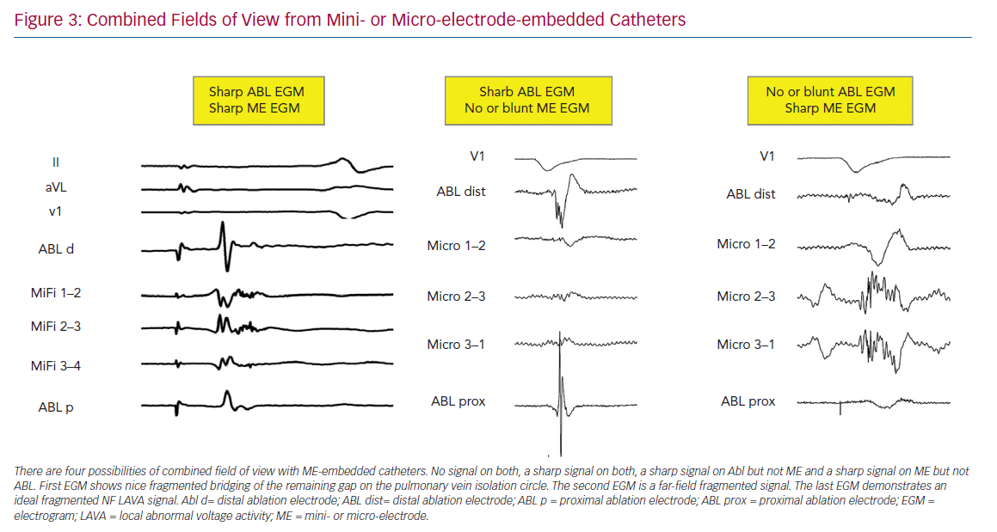
Berte B, Zeppenfeld K, Tung R
Combined Fields of View from Mini- or Micro-electrode-embedded Catheters
Citation: Arrhythmia & Electrophysiology Review 2020;9(3):128–35.
https://doi.org/10.15420/aer.2020.24

