Slide 1
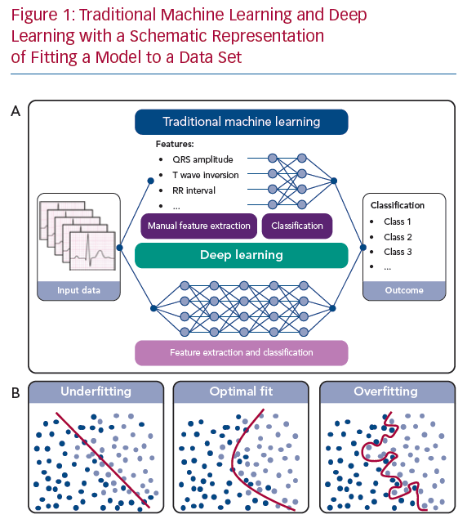
van de Leur RR, Boonstra MJ, Bagheri A, Roudijk RW, Sammani A, Taha K, Doevendans PA, Harst Pvd, van Dam PM, Hassink RJ, van Es R, Asselbergs FW
Traditional Machine Learning and Deep Learning
Citation: Arrhythmia & Electrophysiology Review 2020;9(3):146–54.
https://doi.org/10.15420/aer.2020.26

