Slide 1
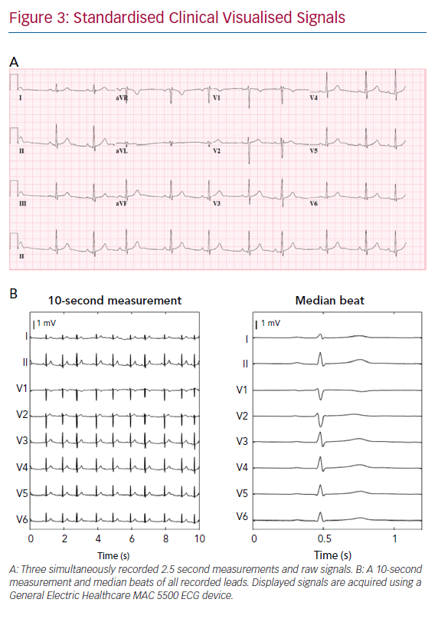
van de Leur RR, Boonstra MJ, Bagheri A, Roudijk RW, Sammani A, Taha K, Doevendans PA, Harst Pvd, van Dam PM, Hassink RJ, van Es R, Asselbergs FW
Standardised Clinical Visualised Signals
Citation: Arrhythmia & Electrophysiology Review 2020;9(3):146–54.
https://doi.org/10.15420/aer.2020.26

