Slide 1
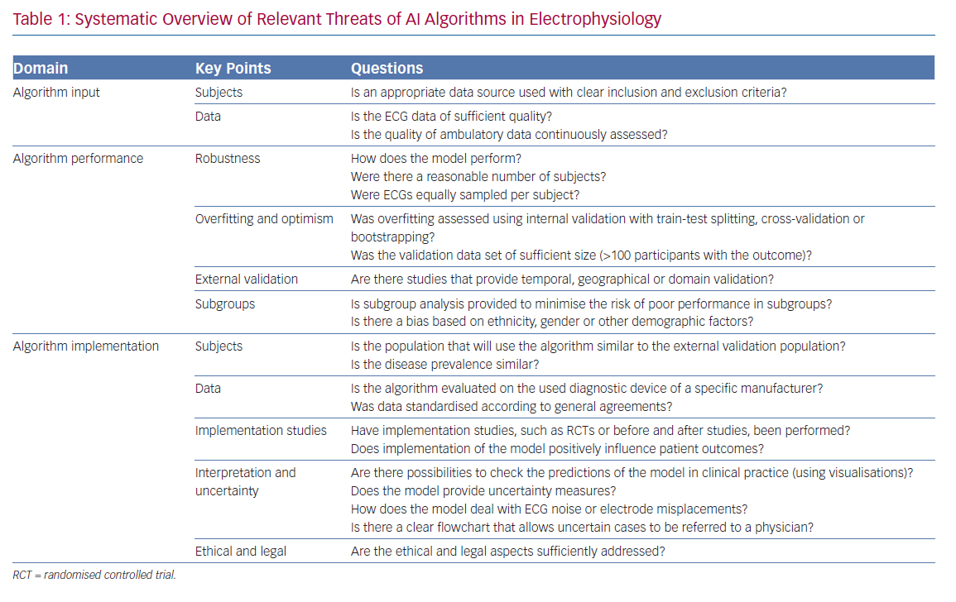
van de Leur RR, Boonstra MJ, Bagheri A, Roudijk RW, Sammani A, Taha K, Doevendans PA, Harst Pvd, van Dam PM, Hassink RJ, van Es R, Asselbergs FW
Systematic Overview of Relevant Threats of AI Algorithms in Electrophysiology
Citation: Arrhythmia & Electrophysiology Review 2020;9(3):146–54.
https://doi.org/10.15420/aer.2020.26

