Slide 1
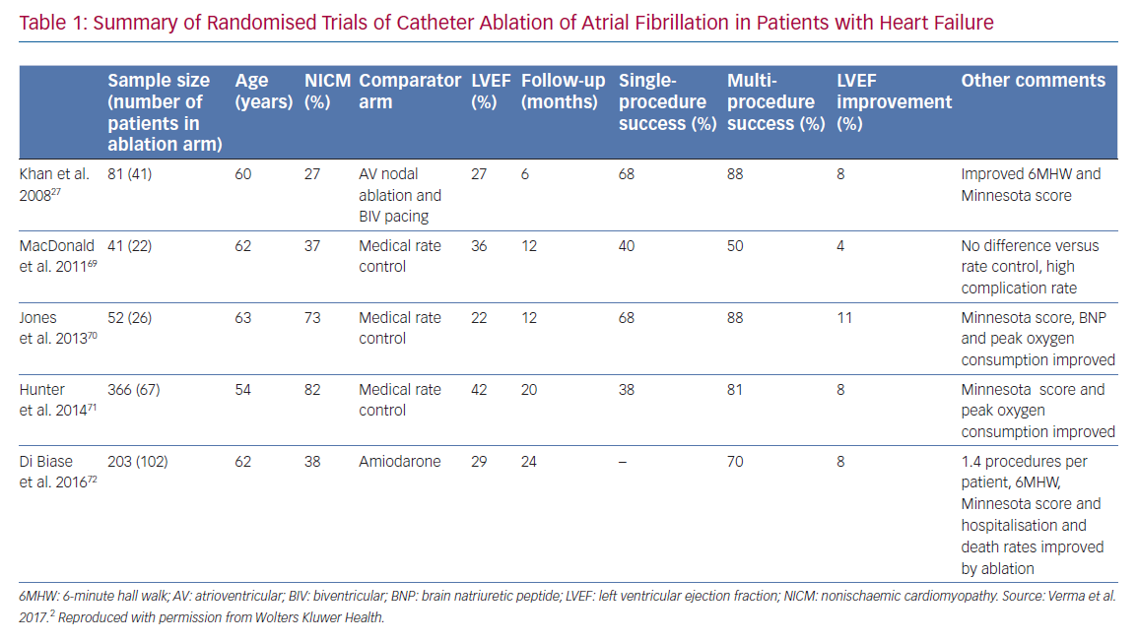
Eysenck W, Saba M
Summary of Randomised Trials of Catheter Ablation
Citation: Arrhythmia & Electrophysiology Review 2020;9(3):161–6.
https://doi.org/10.15420/aer.2020.23

