Slide 1
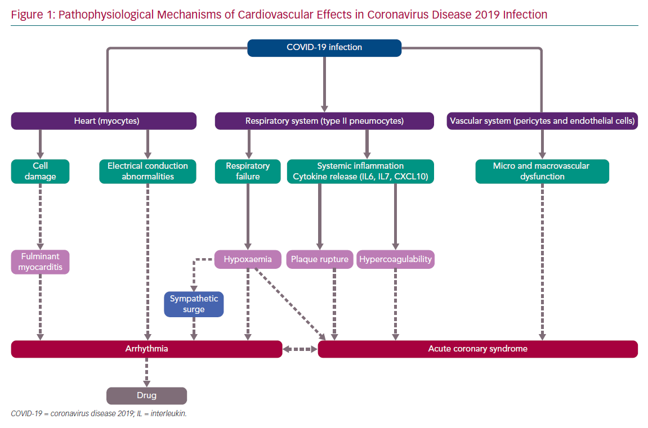
Martínez-Rubio A, Ascoeta S, Taibi F, Guindo-Soldevila J
Pathophysiological Mechanisms of Cardiovascular Effects
Citation: European Cardiology Review 2020;15:e66.
https://doi.org/10.15420/ecr.2020.23

