Slide 1
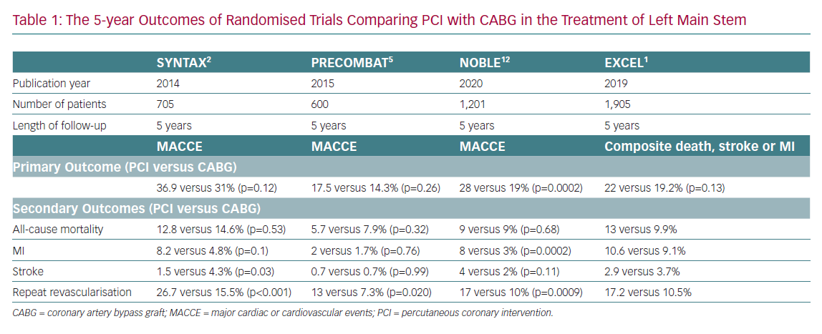
Jahangiri M, Mani K, Yates MT, Nowell J
The 5-year Outcomes of Randomised Trials
Citation: European Cardiology Review 2020;15:e67.
https://doi.org/10.15420/ecr.2020.34

