Slide 1
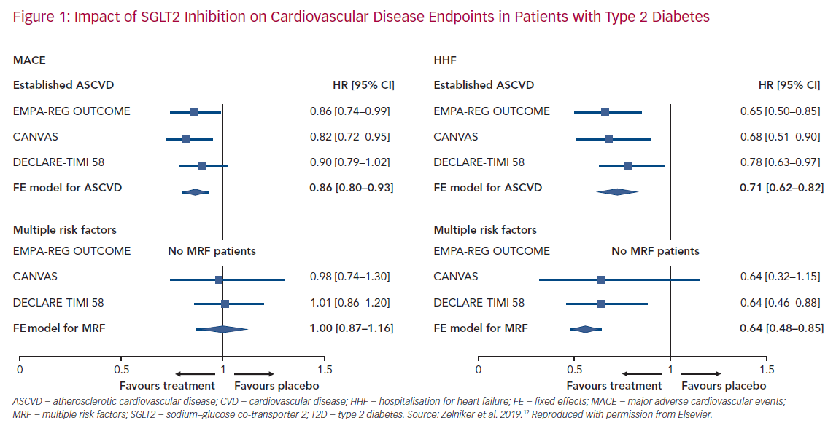
Rosano G, Quek D, Martínez F
Impact of SGLT2 Inhibition on Cardiovascular Disease
Citation: Cardiac Failure Review 2020;6:e31.
https://doi.org/10.15420/cfr.2020.23

