Slide 1
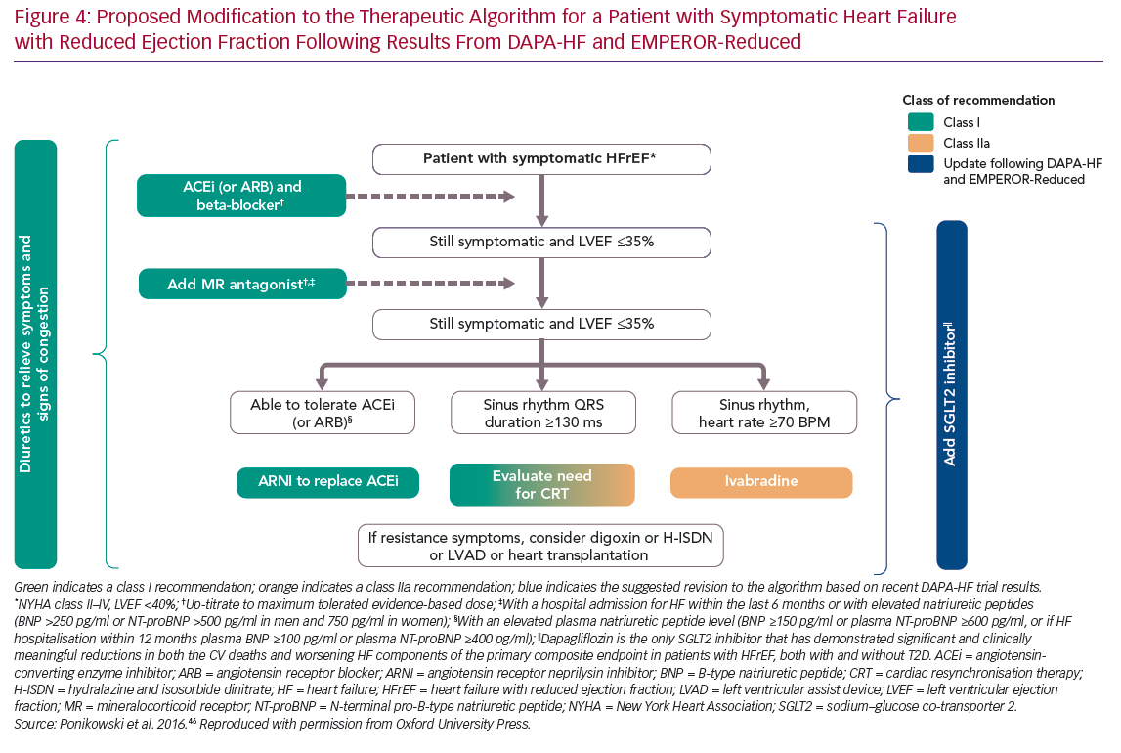
Rosano G, Quek D, Martínez F
Proposed Modification to the Therapeutic Algorithm
Citation: Cardiac Failure Review 2020;6:e31.
https://doi.org/10.15420/cfr.2020.23

