Slide 1
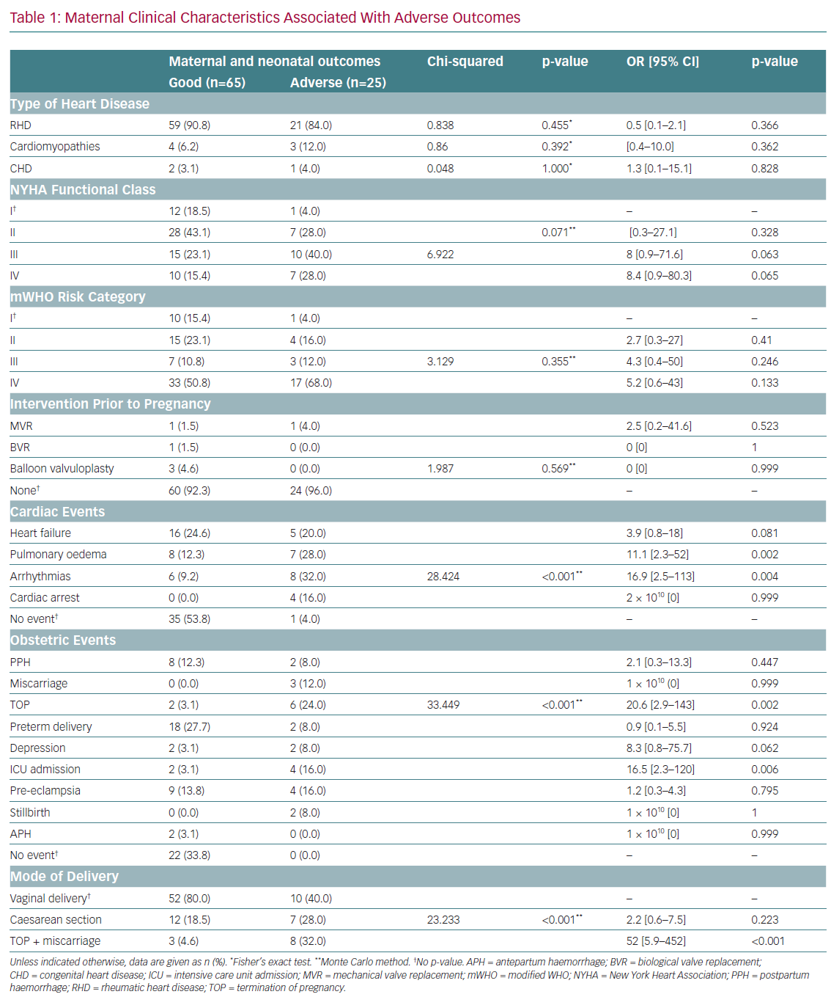
Poli PA, Orang’o EO, Mwangi A, Barasa FA
Maternal Clinical Characteristics Associated With Adverse Outcomes
Citation: European Cardiology Review 2020;15:e68.
https://doi.org/10.15420/ecr.2020.04

