Slide 1
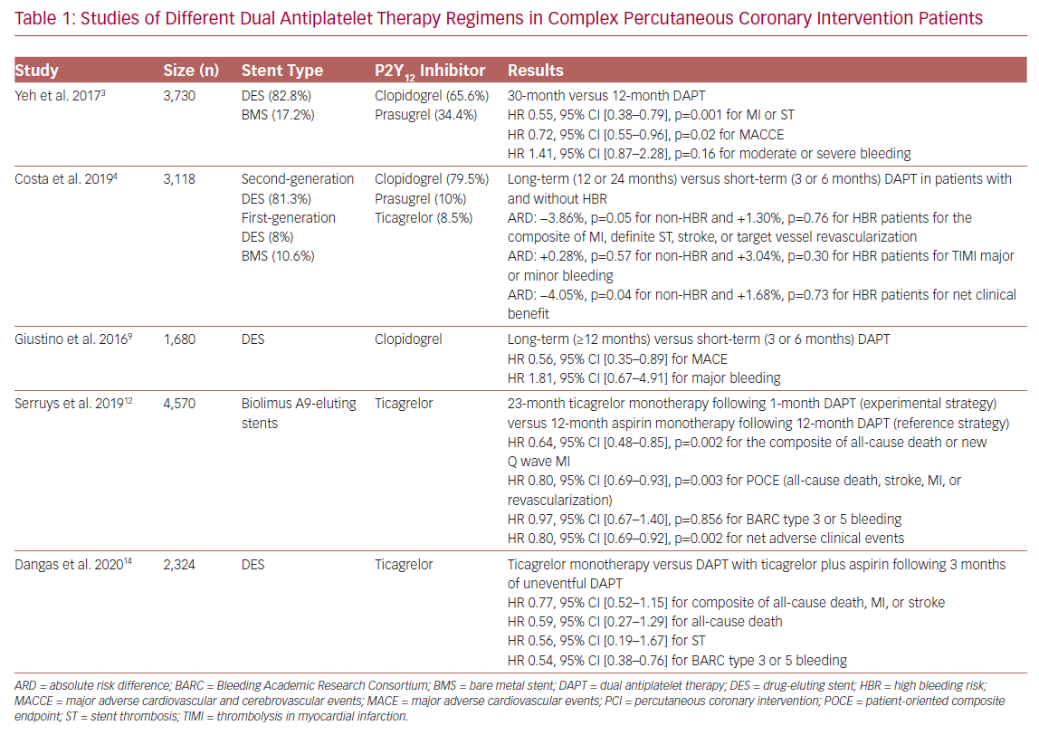
Alexopoulos D, Varlamos C, Benetou DR
Studies of Different Dual Antiplatelet Therapy
Citation: US Cardiology Review 2020;14:e14.
https://doi.org/10.15420/usc.2020.13

