Slide 1
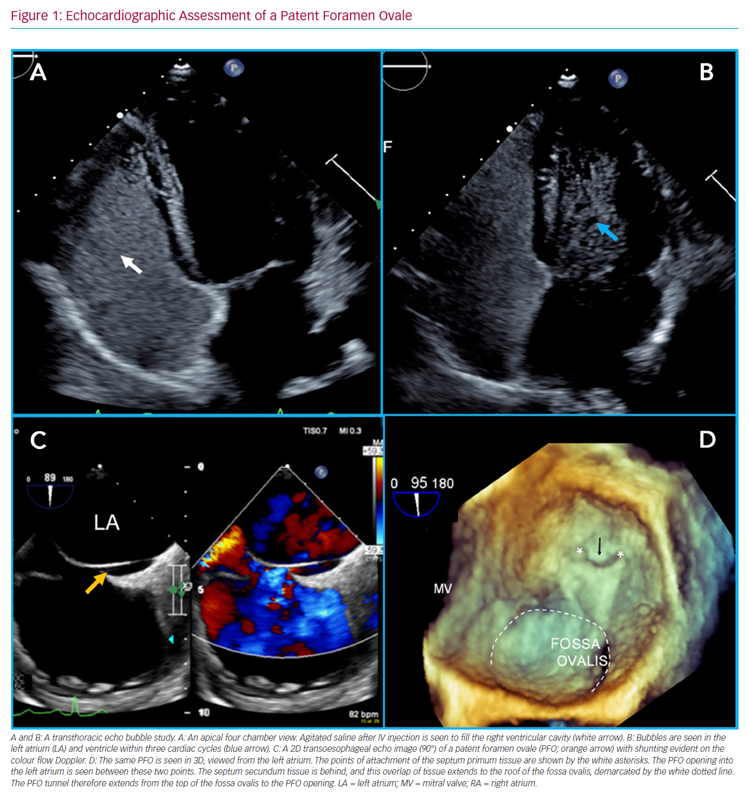
Giblett JP, Williams LK, Kyranis S, Shapiro LM, Calvert PA
Echocardiographic Assessment of a Patent Foramen Ovale
Citation: Interventional Cardiology Review 2020;15:e15.
https://doi.org/10.15420/icr.2019.27

