Slide 1
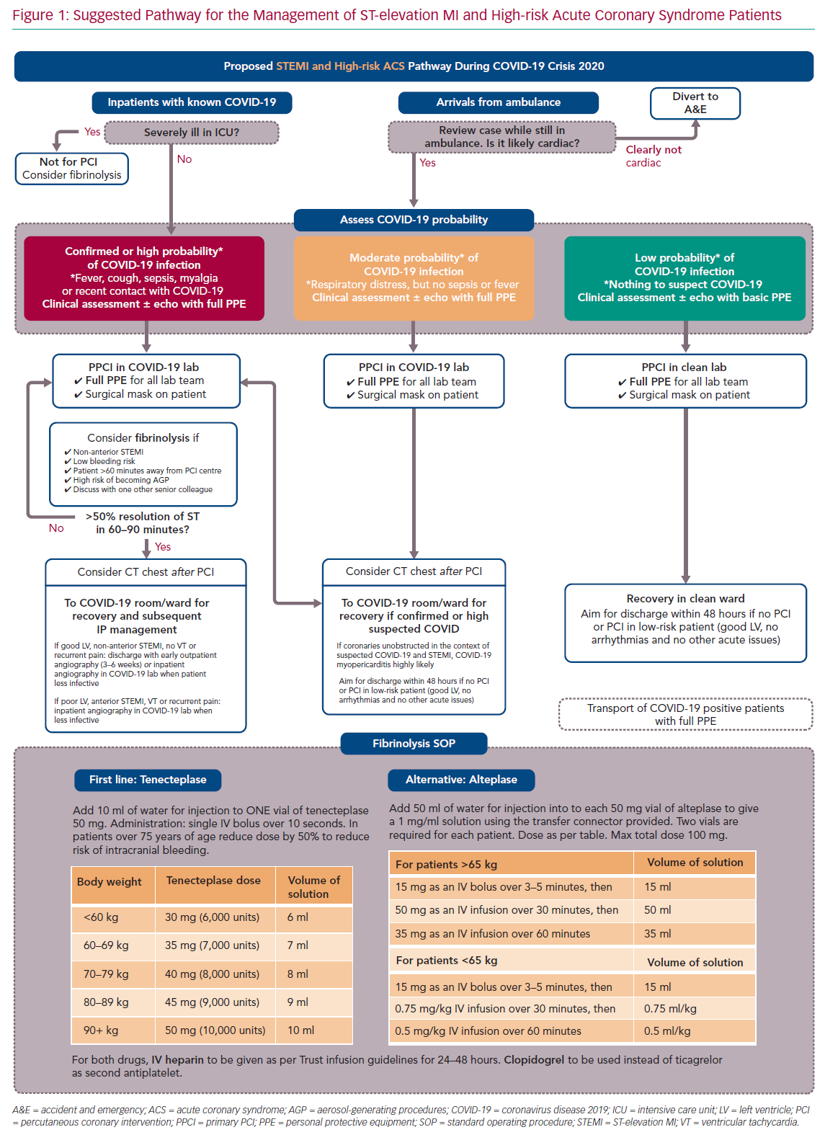
Seligman H, Sen S, Nijjer S, Al-Lamee R, Clifford P, Sethi A, Hadjiloizou N, Kaprielian R, Ramrakha P, Bellamy M, Khan MA, Kooner J, Foale RA, Mikhail G, Baker CS, Mayet J, Malik I, Khamis R, Petraco R
Suggested Pathway for the Management of ST-elevation MI
Citation: Interventional Cardiology Review 2020;15:e16.
https://doi.org/10.15420/icr.2020.21

