Slide 1
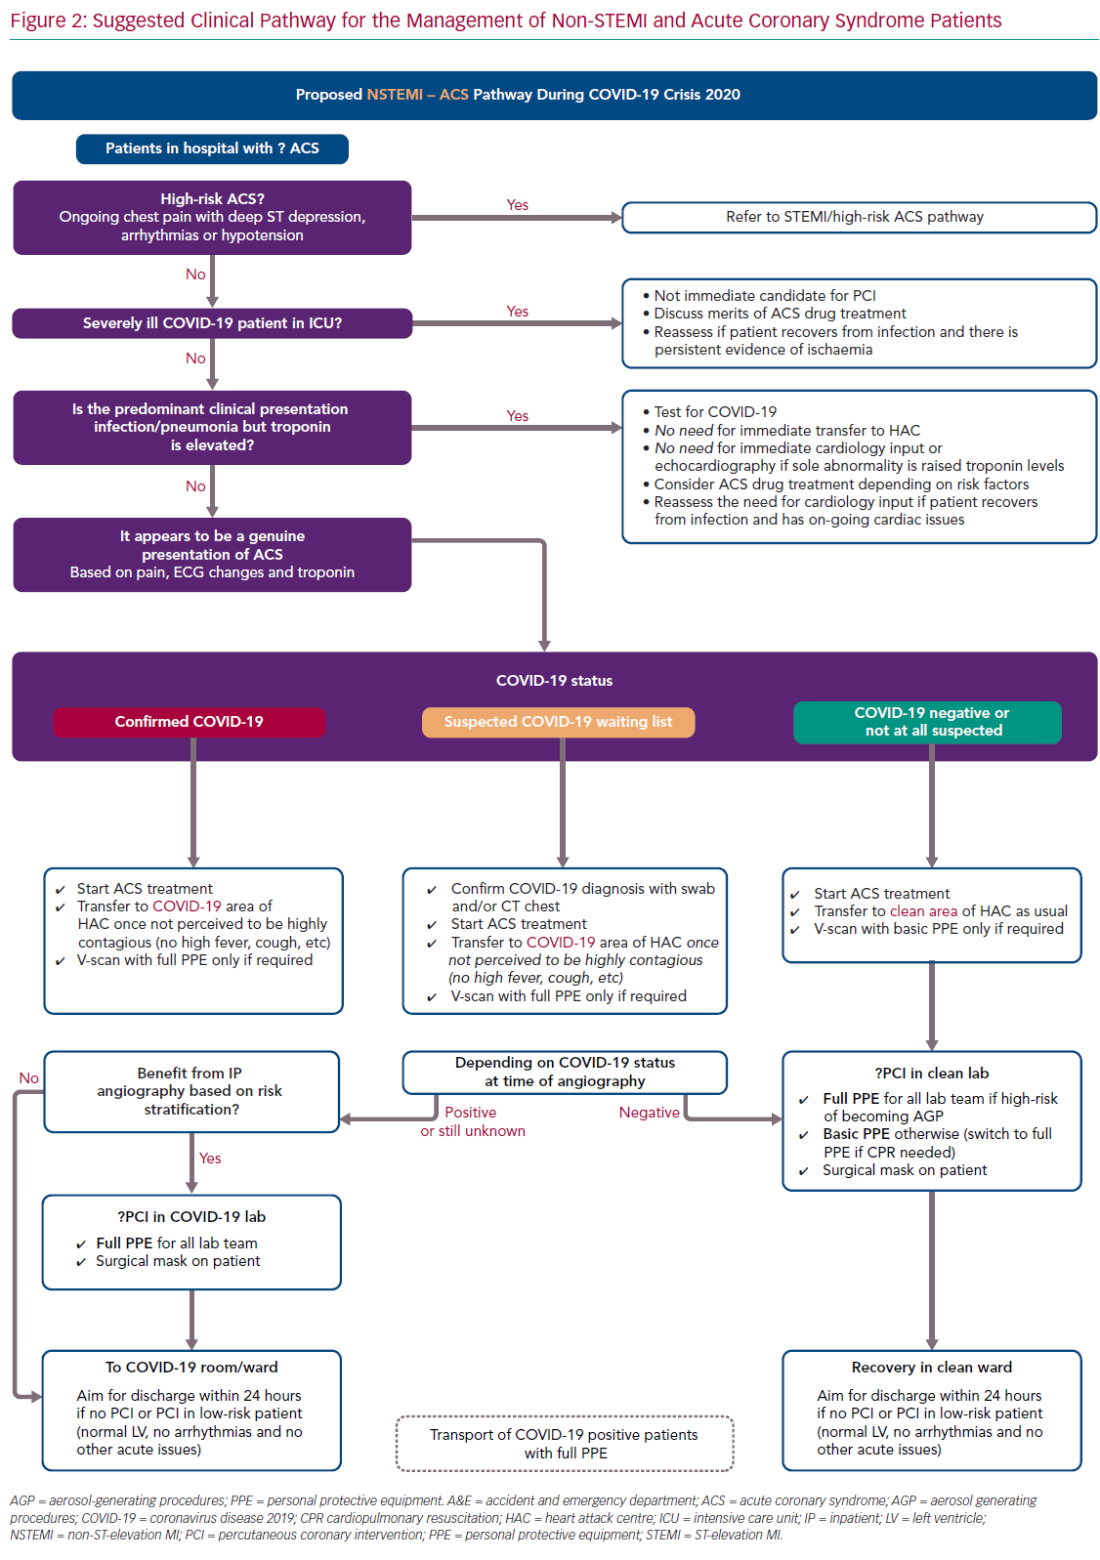
Seligman H, Sen S, Nijjer S, Al-Lamee R, Clifford P, Sethi A, Hadjiloizou N, Kaprielian R, Ramrakha P, Bellamy M, Khan MA, Kooner J, Foale RA, Mikhail G, Baker CS, Mayet J, Malik I, Khamis R, Petraco R
Suggested Clinical Pathway for the Management
Citation: Interventional Cardiology Review 2020;15:e16.
https://doi.org/10.15420/icr.2020.21

