Slide 1
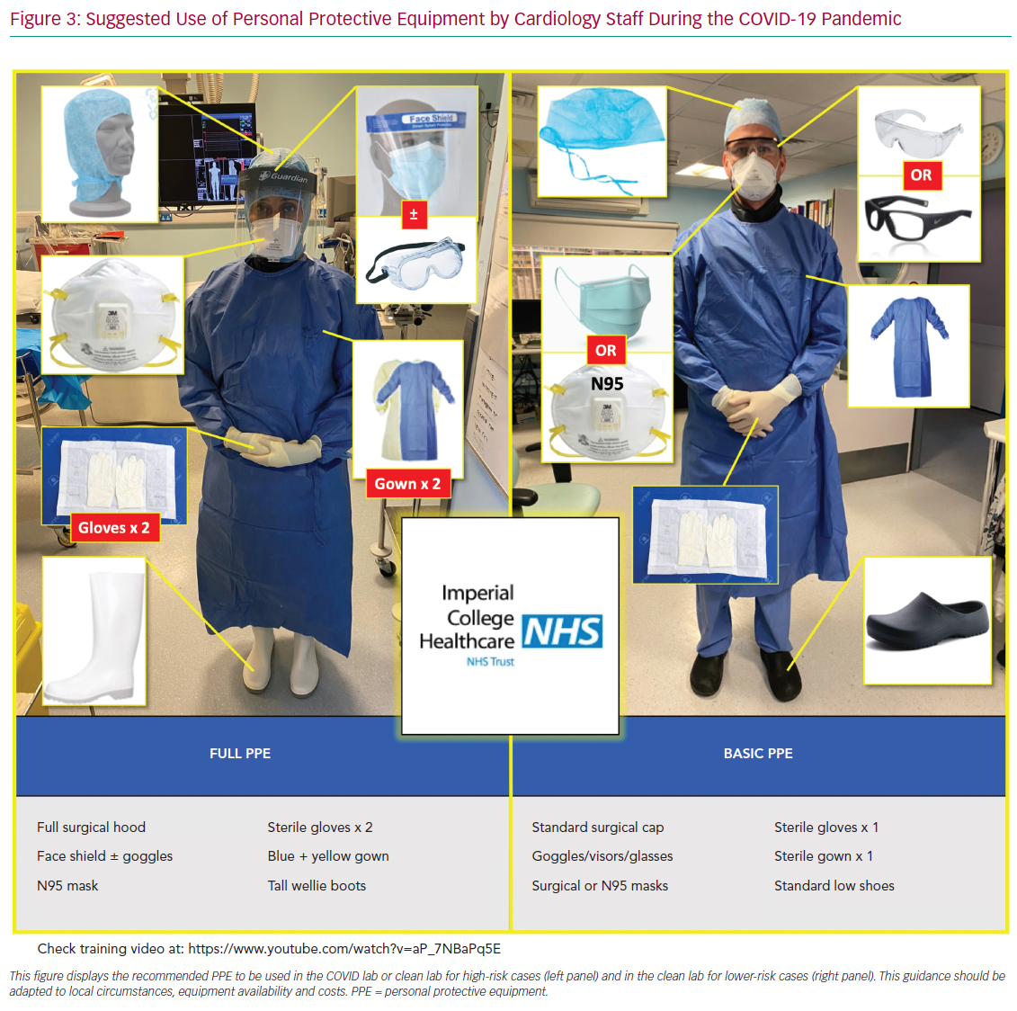
Seligman H, Sen S, Nijjer S, Al-Lamee R, Clifford P, Sethi A, Hadjiloizou N, Kaprielian R, Ramrakha P, Bellamy M, Khan MA, Kooner J, Foale RA, Mikhail G, Baker CS, Mayet J, Malik I, Khamis R, Petraco R
Suggested Use of Personal Protective Equipment
Citation: Interventional Cardiology Review 2020;15:e16.
https://doi.org/10.15420/icr.2020.21

