Slide 1
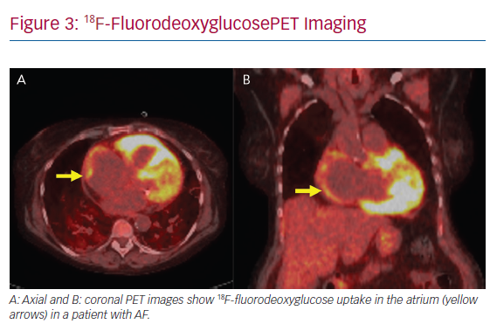
Gilotra N, Okada D, Sharma A, Chrispin J
18F-FluorodeoxyglucosePET Imaging
Citation: Arrhythmia & Electrophysiology Review 2020;9(4):182–8.
https://doi.org/10.15420/aer.2020.09

