Slide 1
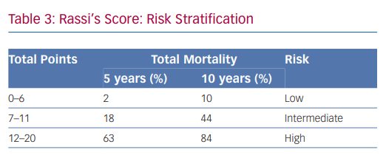
Keegan R, Yeung C, Baranchuk A
Rassi’s Score: Risk Stratification
Citation: Arrhythmia & Electrophysiology Review 2020;9(4):175–81.
https://doi.org/10.15420/aer.2020.27

