Slide 1
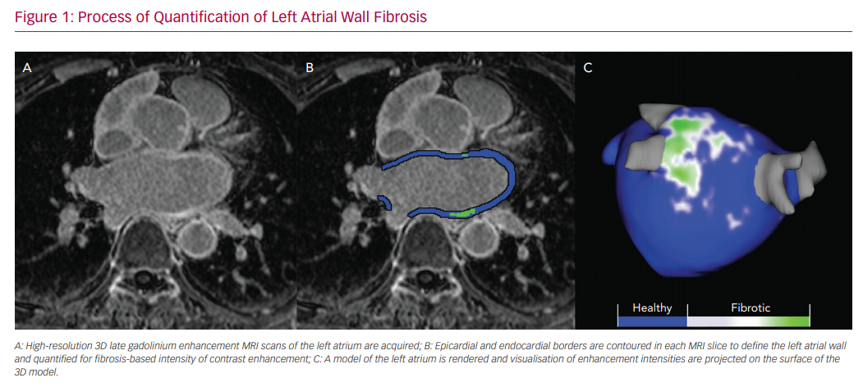
Zhao Y, Dagher L, Huang C, Miller P, Marrouche NF
Process of Quantification of Left Atrial Wall Fibrosis
Citation: Arrhythmia & Electrophysiology Review 2020;9(4):189–94.
https://doi.org/10.15420/aer.2020.21

