Slide 1
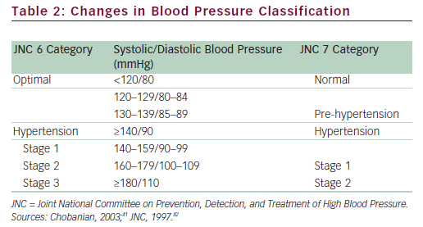
Ferdinand KC
Table 2: Changes in Blood Pressure Classification
Citation: US Cardiology 2010;7(2):25–33
https://doi.org/10.15420/usc.2010.7.2.25

