Slide 1
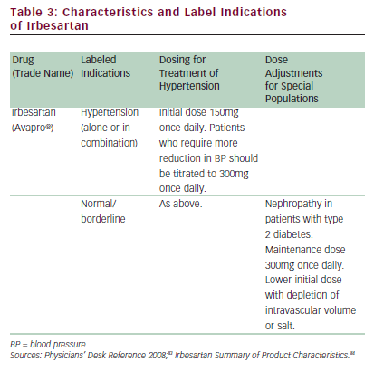
Ferdinand KC
Table 3: Characteristics and Label Indications of Irbesartan
Citation: US Cardiology 2010;7(2):25–33
https://doi.org/10.15420/usc.2010.7.2.25

