Slide 1
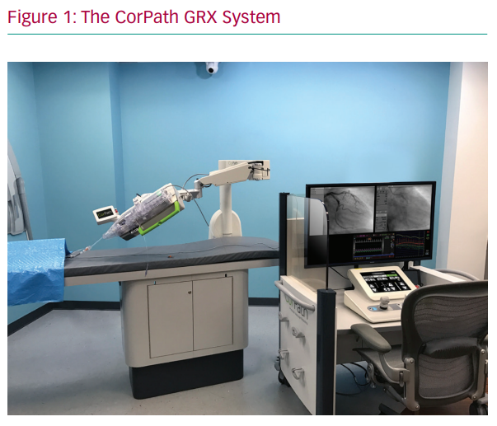
De Silva K, Myat A, Strange J, Weisz G
The CorPath GRX System
Citation: Interventional Cardiology Review 2020;15:e18.
https://doi.org/10.15420/icr.2020.24

