Slide 1
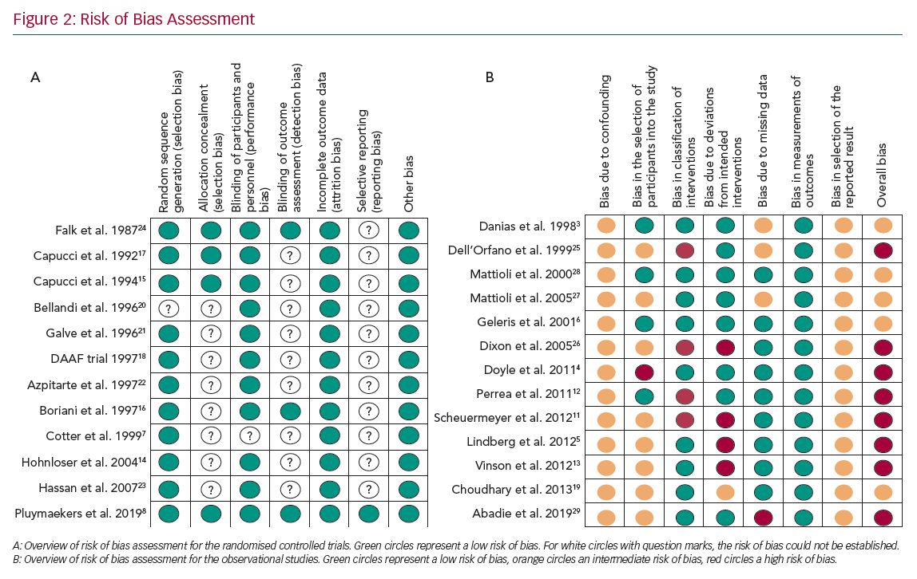
Pluymaekers N, Hermans A, Linz D, Luermans J, Weijs B, Vernooy K, Crijns H
Risk of Bias Assessment
Citation: Arrhythmia & Electrophysiology Review 2020;9(4):195–201.
https://doi.org/10.15420/aer.2020.34

