Slide 1
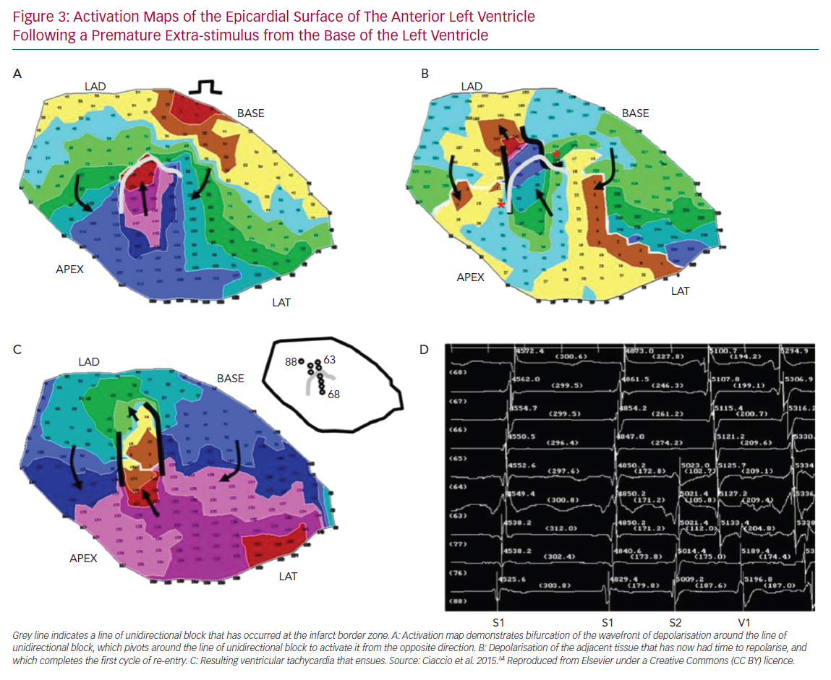
Kotadia ID, Whitaker J, Roney CH, Niederer S, O’Neill M, Bishop M
Activation Maps of the Epicardial Surface of The Anterior Left Ventricle Following a Premature Extra-stimulus from the Base of the Left Ventricle
Citation: Arrhythmia & Electrophysiology Review 2020;9(4):202–10.
https://doi.org/10.15420/aer.2020.04

