Slide 1

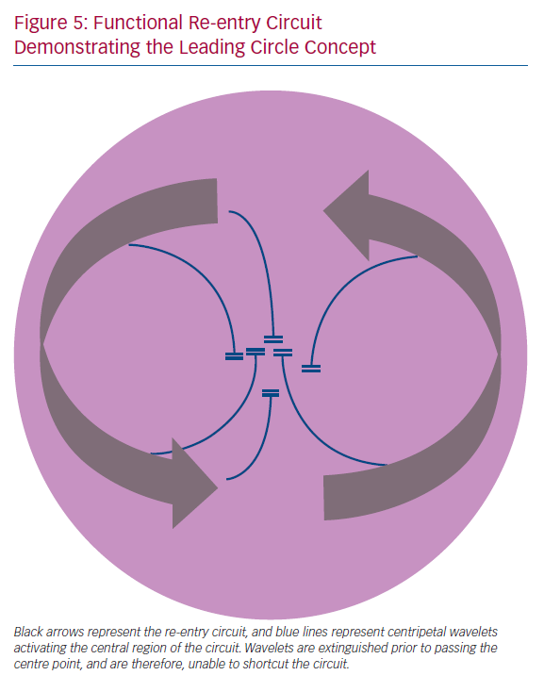
Kotadia ID, Whitaker J, Roney CH, Niederer S, O’Neill M, Bishop M
Functional Re-entry Circuit Demonstrating the Leading Circle Concept
Citation: Arrhythmia & Electrophysiology Review 2020;9(4):202–10.
https://doi.org/10.15420/aer.2020.04

