Slide 1
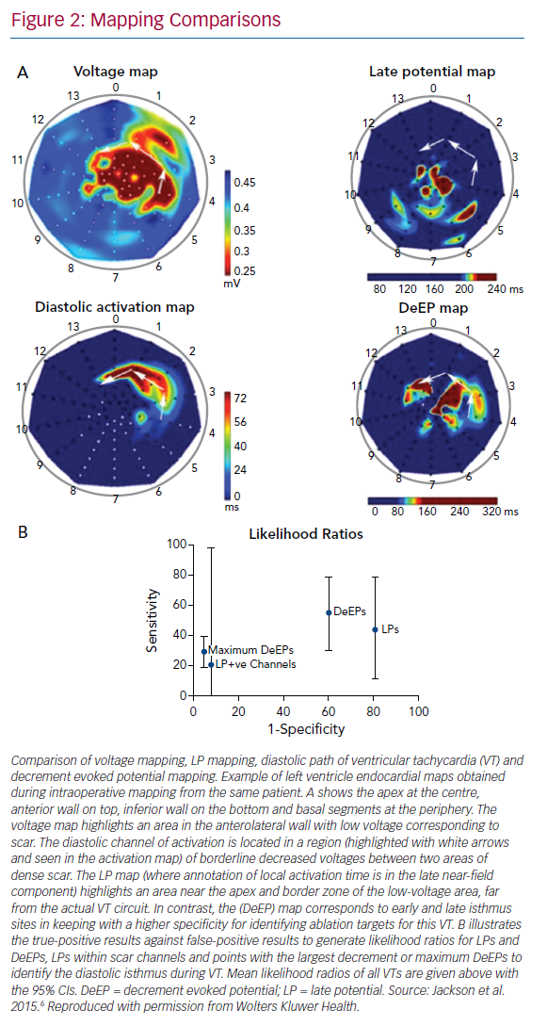
Bhaskaran A, Fitzgerald J, Jackson N, Gizurarson S, Nanthakumar K, Porta-Sánchez A
Mapping Comparisons
Citation: Arrhythmia & Electrophysiology Review 2020;9(4):211–8.
https://doi.org/10.15420/aer.2020.25

