Slide 1
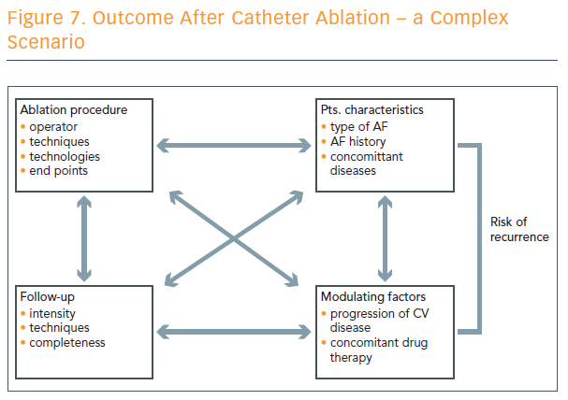
Outcome After Catheter Ablation – a Complex Scenario
Citation: Arrhythmia & Electrophysiology Review 2017;6(4 Suppl 1):8-9
https://doi.org/10.15420/aer.2017.6.4.S1

