Slide 1
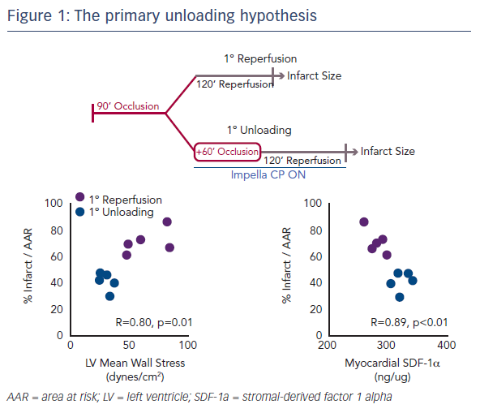
Kapur NK
The primary unloading hypothesis
Citation: Interventional Cardiology Review 2017;12(2 Suppl 2):7-8.
https://doi.org/10.15420/icr.2017.12.2.S2

