Slide 1
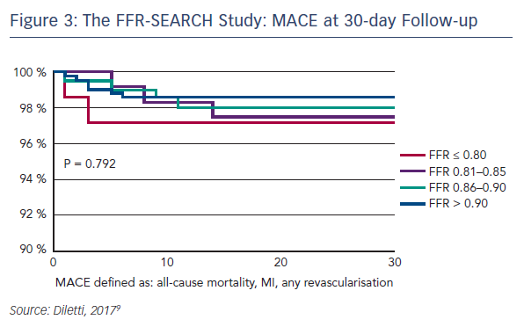
Diletti R
The FFR-SEARCH Study: MACE at 30-day Follow-up
Citation: Interventional Cardiology Review 2017;12(2 Suppl 1):3.
https://doi.org/10.15420/icr.2017:12:2.S1

