Slide 1
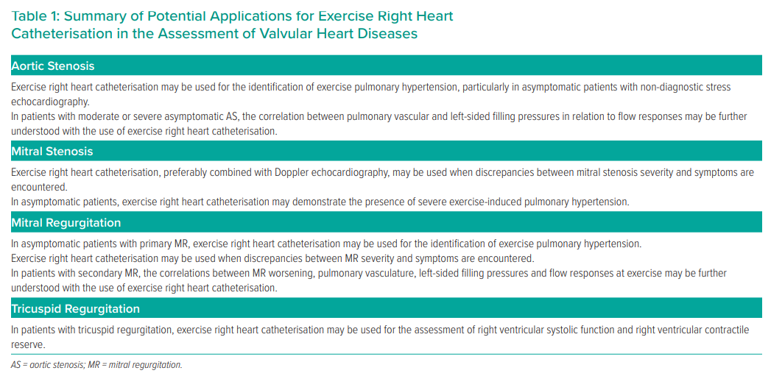
Valle FH, Mohammed B, Wright SP, Bentley R, Fam NP, Mak S
Summary of Potential Applications for Exercise Right Heart Catheterisation in the Assessment of Valvular Heart Diseases
Citation: Interventional Cardiology Review 2021;16:e01.
https://doi.org/10.15420/icr.2020.17

