Slide 1
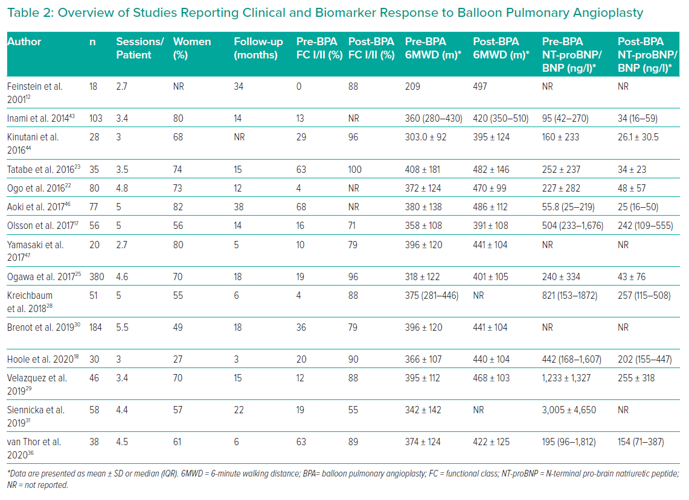
Coghlan JG, Rothman AM, Hoole SP
Overview of Studies Reporting Clinical and Biomarker Response to Balloon Pulmonary Angioplasty
Citation: Interventional Cardiology Review 2021;16:e02.
https://doi.org/10.15420/icr.2020.14

