Slide 1
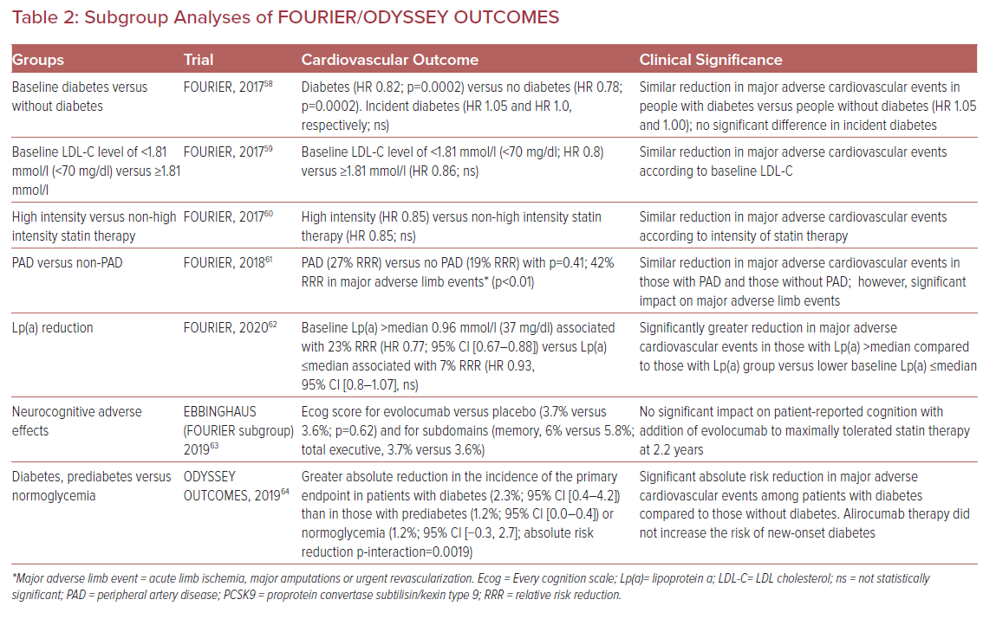
Xu J, Shapiro MD
Subgroup Analyses of FOURIER/ODYSSEY OUTCOMES
Citation: US Cardiology Review 2021;15:e01.
https://doi.org/10.15420/usc.2020.17

