Slide 1
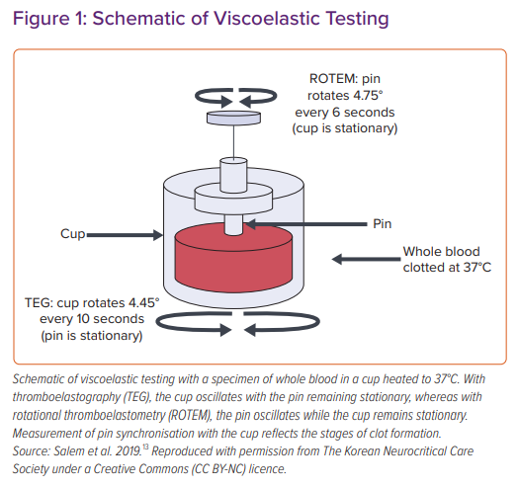
Rali AS, Salem AM, Gebre M, Garies TM, Taduru S, Bracey Jr AW
Schematic of Viscoelastic Testing
Citation: Cardiac Failure Review 2021;7:e01.
https://doi.org/10.15420/cfr.2020.22

