Slide 1
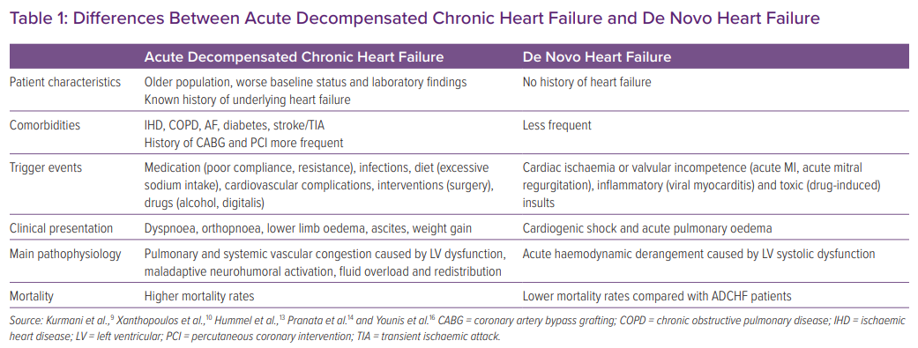
Raffaello WM, Henrina J, Huang I, Lim MA, Suciadi LP, Siswanto BB, Pranata R
Differences Between Acute Decompensated Chronic Heart Failure and De Novo Heart Failure
Citation: Cardiac Failure Review 2021;7:e02.
https://doi.org/10.15420/cfr.2020.20

