Slide 1
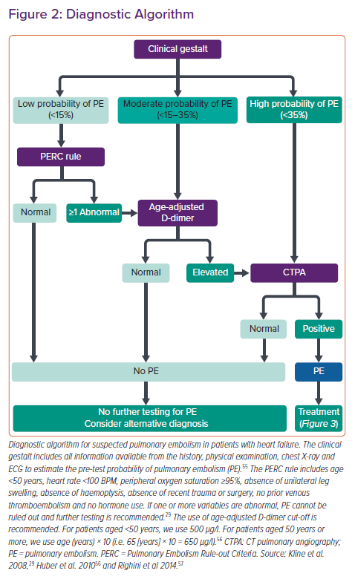
Arrigo M, Huber LC
Diagnostic Algorithm
Citation: Cardiac Failure Review 2021;7:e03.
https://doi.org/10.15420/cfr.2020.26

