Slide 1

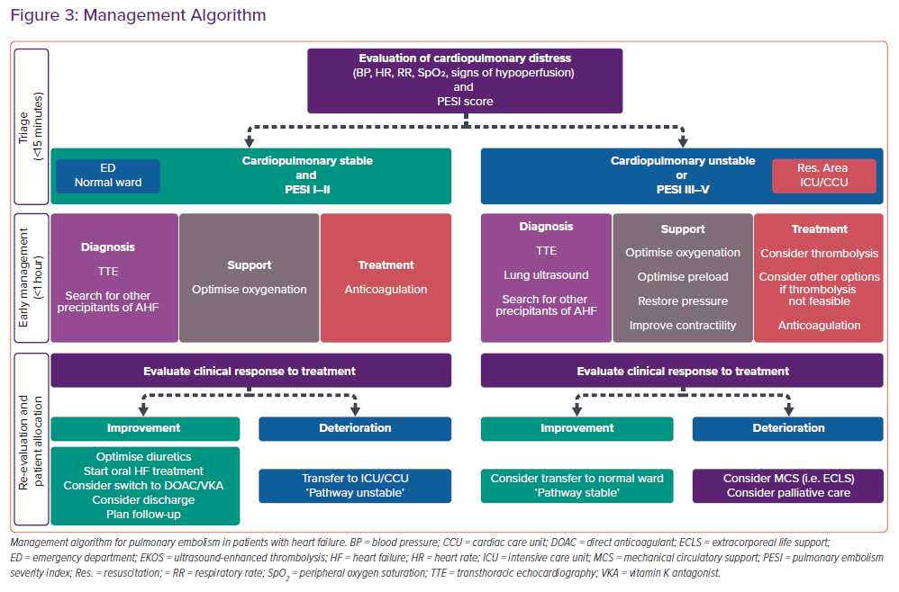
Arrigo M, Huber LC
Management Algorithm
Citation: Cardiac Failure Review 2021;7:e03.
https://doi.org/10.15420/cfr.2020.26

