Slide 1
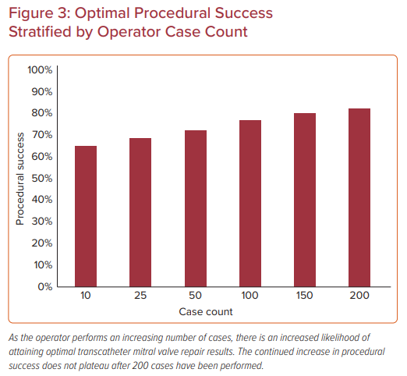
Sheehy JP, Chhatriwalla AK
Optimal Procedural Success Stratified by Operator Case Count
Citation: US Cardiology Review 2021;15:e02.
https://doi.org/10.15420/usc.2020.02

