Slide 1
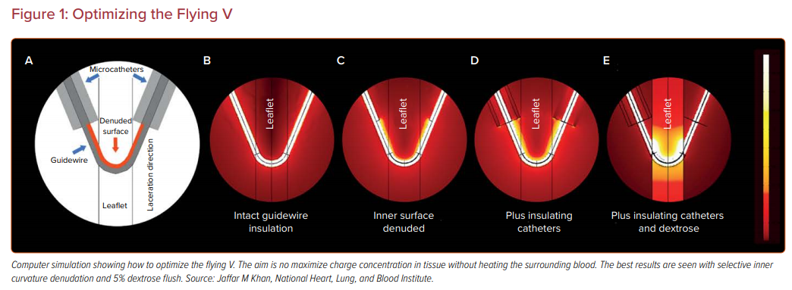
Khan JM, Rogers T, Greenbaum AB, Babaliaros V
Optimizing the Flying V
Citation: US Cardiology Review 2021;15:e03.
https://doi.org/10.15420/usc.2020.27

