Slide 1

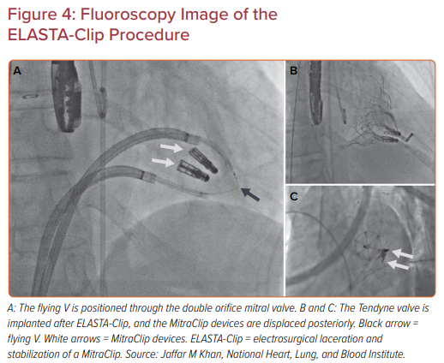
Khan JM, Rogers T, Greenbaum AB, Babaliaros V
Fluoroscopy Image of the ELASTA-Clip Procedure
Citation: US Cardiology Review 2021;15:e03.
https://doi.org/10.15420/usc.2020.27

