Slide 1
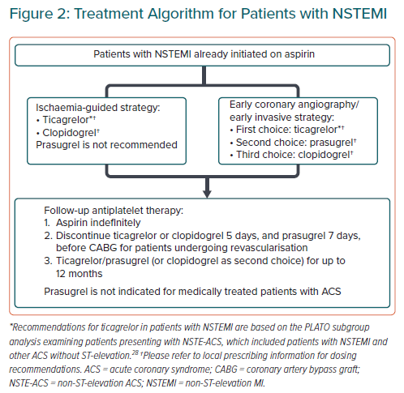
Tan JW, Chew DP, Abdul Kader MAS, Ako J, Bahl VK, Chan M, Park KW, Chandra P, Hsieh IC, Huan DQ, Johar S, Juzar DA, Kim BK, Lee CW, Lee MKY, Li YH, Almahmeed W, Sison EO, Tan DSY, Wang YC, Yeh SJ, Montalescot G
Treatment Algorithm for Patients with NSTEMI
Citation: European Cardiology Review 2021;16:e02.
https://doi.org/10.15420/ecr.2020.40

