Slide 1
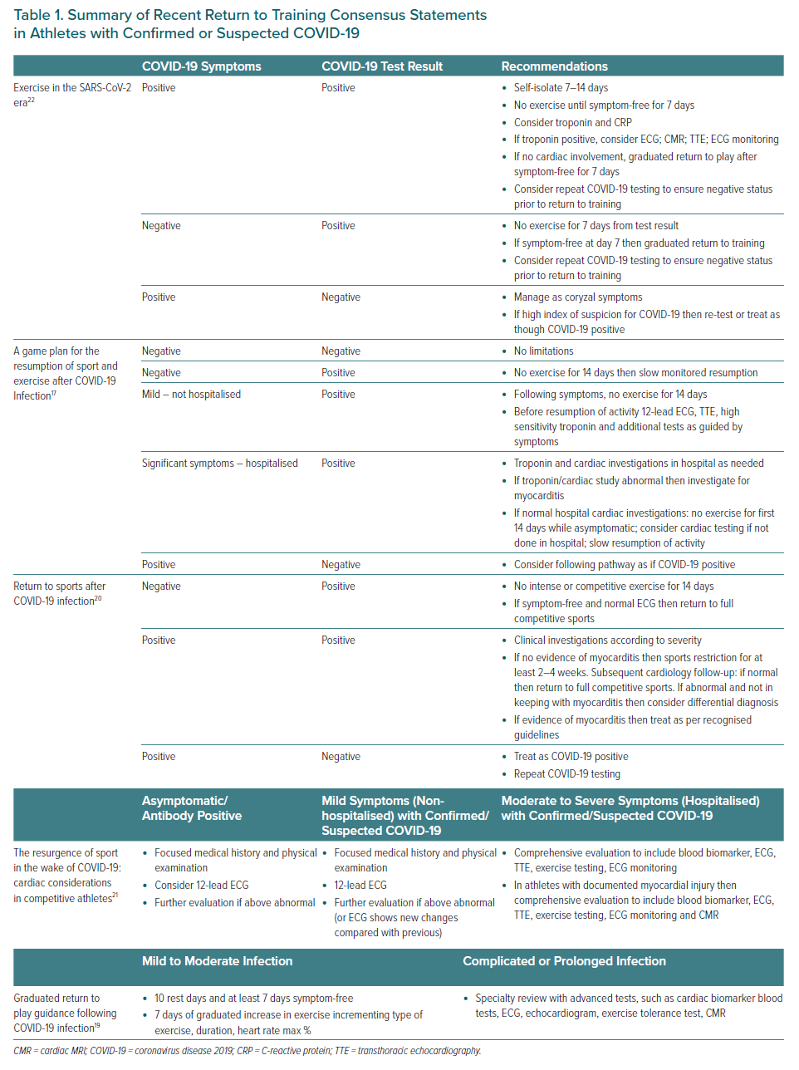
Augustine DX, Keteepe-Arachi T, Malhotra A
Summary of Recent Return to Training Consensus Statements in Athletes with Confirmed or Suspected COVID-19
Citation: European Cardiology Review 2021;16:e03.
https://doi.org/10.15420/ecr.2020.36

