Slide 1
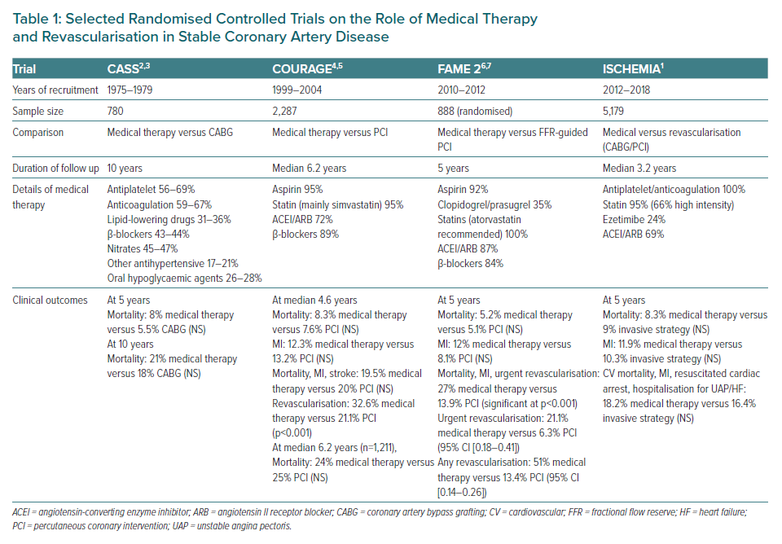
Yap JJL, Chew DP, Stone G, Tan JWC
Selected Randomised Controlled Trials on the Role of Medical Therapy and Revascularisation in Stable Coronary Artery Disease
Citation: European Cardiology Review 2021;16:e04.
https://doi.org/10.15420/ecr.2020.48

