Slide 1
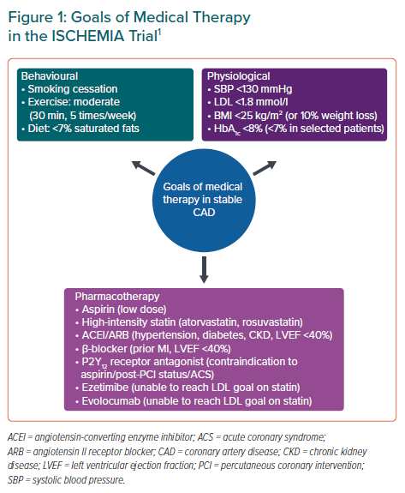
Yap JJL, Chew DP, Stone G, Tan JWC
Goals of Medical Therapy in the ISCHEMIA Trial
Citation: European Cardiology Review 2021;16:e04.
https://doi.org/10.15420/ecr.2020.48

