Slide 1

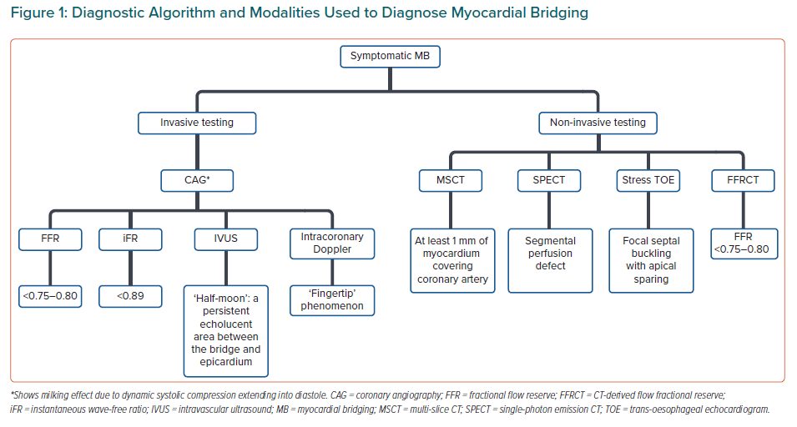
Khadke S, Vidovic J, Patel V
Diagnostic Algorithm and Modalities Used to Diagnose Myocardial Bridging
Citation: European Cardiology Review 2021;16:e05.
https://doi.org/10.15420/ecr.2020.33

