Slide 1
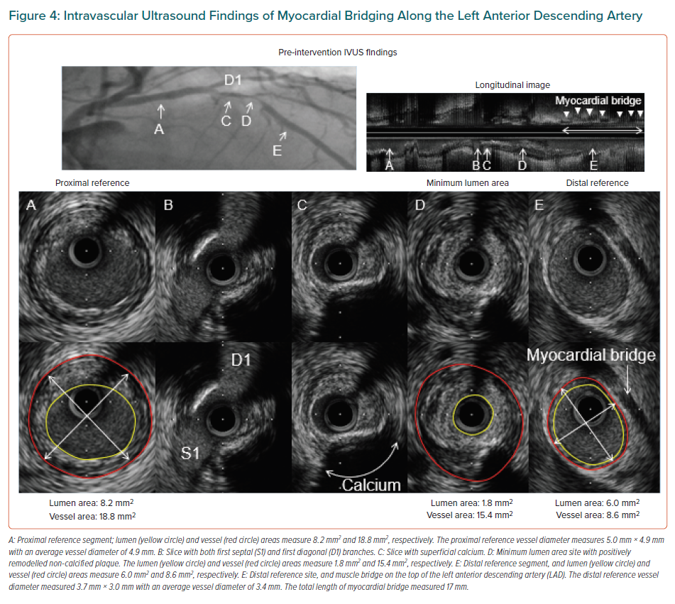
Khadke S, Vidovic J, Patel V
Intravascular Ultrasound Findings of Myocardial Bridging Along the Left Anterior Descending Artery
Citation: European Cardiology Review 2021;16:e05.
https://doi.org/10.15420/ecr.2020.33

