Slide 1
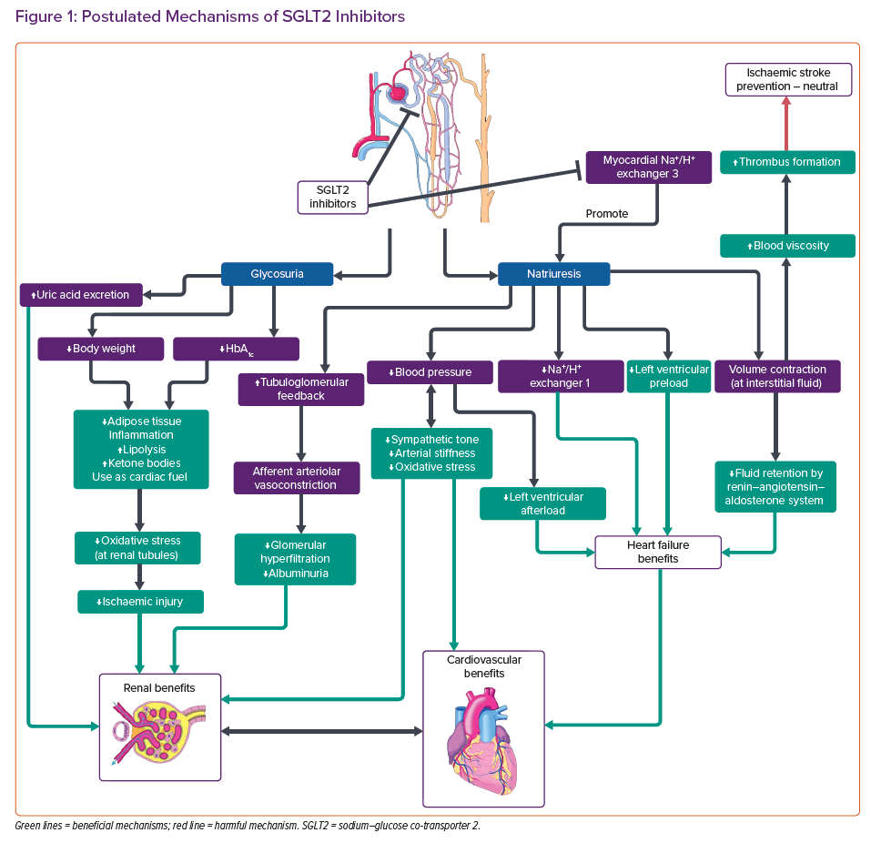
Lo CWH, Fei Y, Cheung BMY
Postulated Mechanisms of SGLT2 Inhibitors
Citation: Cardiac Failure Review 2021;7:e04.
https://doi.org/10.15420/cfr.2020.19

