Slide 1
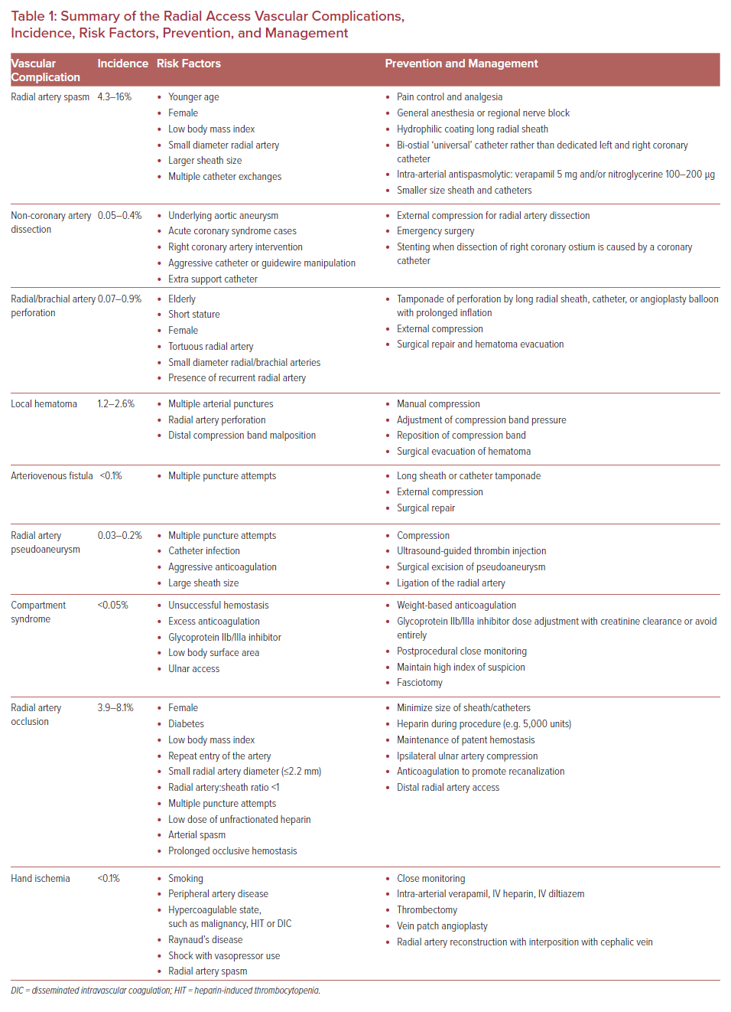
Riangwiwat T, Blankenship JC
Summary of the Radial Access Vascular Complications, Incidence, Risk Factors, Prevention, and Management
Citation: US Cardiology Review 2021;15:e04.
https://doi.org/10.15420/usc.2020.23

